Slide 1
Sponsor-Investigator IND training: module 2 Sponsor and Investigator Responsibilities
IND/IDE Support Program
May 8, 2023

Slide 2
Overview
Sponsor Regulatory Obligations
Investigator Regulatory Obligations
Overlapping Regulatory Obligations of Sponsors and Investigators
Summary: Required Reporting Documents

Slide 3
Sponsor Regulatory obligations
Selecting and Informing Site Investigators
Monitoring: Review of Ongoing Investigations
Maintain the IND: IND Change Reporting and Progress/Status Reporting
Drug Safety (IND Safety Reporting)
IND Protocol(s) and Review
Pharmacology and Toxicology
Investigational Product Handling and Accountability

Slide 4
Selecting and informing investigators

Slide 5
Selecting investigators
Sponsors are responsible for selecting investigators qualified by training and experience and providing them with the information they need to conduct an investigation properly (21 CFR 312.50)
Before permitting an investigator to begin participation in an investigation, the sponsor must obtain the following (21 CFR 312.53):
(1) A signed investigator statement (Form FDA-1572)
(2) Curriculum vitae or other statement of qualifications of the investigator showing the education, training, and experience that qualifies the investigator as an expert in the clinical investigation of the study drug for the use being studied.

Slide 6
Informing investigators
Before the investigation begins, the sponsor should provide all relevant study materials to the investigators and should consider conducting a study protocol-dedicated training session for all key personnel at the site.
The sponsor must continuously keep each participating investigator informed of updated study documents (protocols, investigator brochures, adverse event profiles, etc.) as well as updated safety information.
When new information is available to the study team, or when an amendment is approved by the IRB, the information and updated documents should be distributed by email or by an in-person meeting with the study team
Additional references: 21 CFR 312.32; 21 CFR 312.23(a)(5)

Slide 7
Monitoring and review of ongoing investigations

Slide 8
Monitoring: review of ongoing investigations
Sponsors are responsible for ensuring proper monitoring of the investigation(s), ensuring that the investigation(s) is conducted in accordance with the general investigational plan and protocols contained in the IND (21 CFR 312.50).
Selecting Monitors
A sponsor must select a monitor qualified by training and experience to monitor the progress of the investigation (21 CFR 312.53(d))
Review of Ongoing Investigations
The sponsor must monitor the progress of all clinical investigations being conducted under its IND (21 CFR 312.56(a))
The ORC as Study Monitor
The Office of Research Compliance (ORC) conducts regular institutional monitoring of clinical research. The ORC may also provide study monitoring as a service. If interested, please reach out to the Office of Research Compliance at ORC@chop.edu.

Slide 9
Monitoring: Review of ongoing investigations
A sponsor who discovers that an investigator is not complying with the general investigational plan, or protocol, or the requirements of this part or other applicable parts must:
Promptly either secure compliance, or
Discontinue shipments of the investigational new drug to the investigator and end the investigator's participation in the investigation.
If the investigator's participation in the investigation is ended, the sponsor must require that the investigator dispose of or return the investigational drug in accordance with the requirements of 312.59 and must notify the FDA. (21 CFR 312.56)

Slide 10
Monitoring: Review of ongoing investigations
The sponsor must review and evaluate the evidence relating to the safety and effectiveness of the drug as it is obtained from the investigator.
The sponsors must make such reports to FDA regarding information relevant to the safety of the drug as are required under 312.32.
The sponsor must make annual reports on the progress of the investigation in accordance with 312.33. (21 CFR 312.56)

Slide 11
Submission and Maintenance of the Investigational New Drug Application (IND)

Slide 12
Preparing AN FDA submission
Contents of submission:
Cover letter clearly indicating the type of submission
Form FDA 1571 is required with all correspondence
Note: Form FDA 3926 may be used with single patient IND submissions
Table of contents listing all documents or sections for the submission
Use Templates for proper order and format of submissions
For document revisions
Submit Tracked and Clean versions of the documents
Include Summary of Changes (for updated protocols, IBs, etc.)

Slide 13
Preparing AN FDA submission
Submissions for drug studies are sent to the Center for Drug Evaluation and Research (CDER) Using NextGen Portal

Slide 14
PREPARING AN FDA SUBMISSION
Submissions for studies of biologics are sent to CBER using CBERDCC_eMailSub@fda.hhs.gov email
Do not use "CHOP Secure" email – FDA will not be able to open these
Page Numbers – Beginning to end, not just each section (page n of z)
CBER submissions order of preferences (see letter to sponsors)
ESG
Email
Electronic media
Paper
Note for all FDA Communications
You may email with the FDA RPM, CHOP email to FDA is secure.
Phone conversations with the FDA should always be followed by email to document correspondence.

Slide 15
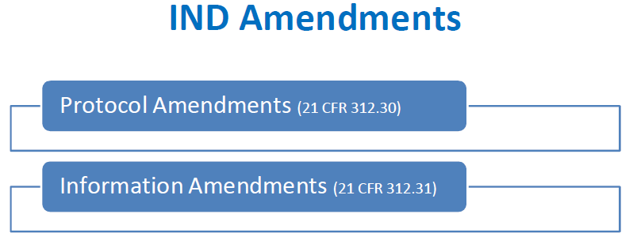
Maintain the IND: amendments

Slide 16
Amendments
Materials submitted to the FDA must be maintained
If revised, FDA is notified by submission of an amendment
Protocol or Information Amendments
Changes to any of the following sections of the IND application:
Protocol, Plan, IB
Chemistry, Manufacturing, and Control Information
Pharmacology and Toxicology Information
Previous human experience with the investigational drug
FDA Form 1572: Investigator Agreement
Additional information

Slide 17
Protocol amendments
Types of FDA Protocol Amendments | Purpose of Submission | When should it be submitted to the FDA? | Special Considerations?
Protocol Amendment:New Protocol | New protocol under existing active IND | New Protocols are expected to be submitted to the FDA prior to being implemented.
Protocol Amendment: Change in Protocol | There are changes to a previously submitted protocol that need to be communicated to the FDA. | Changes are expected to be submitted to the FDA prior to being implemented. | This includes: -Phase 1 protocol changes that significantly affect subject safety -Phase 2 or 3 protocol changes that significantly affects subject safety, the scope of the investigation, or the scientific quality of the study
Protocol Amendment:New Investigator (or) (Change Investigator) | A new investigator is added to a previously submitted protocol. | Within 30 days of the investigator being added. | -When there are multiple submissions of this type, they can be reported in 30 day intervals
*When feasible, When several submissions of new protocols or protocol changes are anticipated during a short period, the sponsor is encouraged, to the extent feasible, to include these all in a single submission
Note: A protocol change intended to eliminate hazard to subjects may be implemented immediately, and both FDA and IRB are notified.
https://www.fda.gov/drugs/investigational-new-drug-ind-application/ind-application-reporting-protocol-amendments

Slide 18
Protocol amendments
When several submissions of new protocols or protocol changes are anticipated during a short period, the sponsor is encouraged, to the extent feasible, to include these all in a single submission.
If the sponsor would like the FDA to comment on the submission, this should be requested in the submission, and the specific questions for the FDA should be clearly listed.
Amendments to the IND that contain new or revised protocols should:
Build logically on previous submissions
Be supported by additional information, and the rationale for the changes must be clearly explained
Changes to existing Protocols or New Protocols under an Existing IND may be implemented provided two conditions are met (in either order):
The sponsor has submitted the protocol or change to FDA for its review; and
The protocol has been approved by the Institutional Review Board (IRB).

Slide 19
Information amendment
An information amendment is used to report essential information of the IND that is not within the scope of a protocol amendment, IND safety reports, or annual report. Examples of information requiring an information amendment include:
A report regarding the discontinuance of a clinical investigation
Chemistry, Manufacturing, and Control Information
Pharmacology and Toxicology Information
Previous human experience with the investigational drug
FDA Form 1572: Investigator Agreement (Changes other than New Investigator)
Additional information or changes related to the safety of the study or product
IND Amendments should be submitted as necessary but not more than every 30 days.
For additional information about ‘Information Amendments’, specifically related to changes to the CMC section or the Pharmacology and Toxicology Section, please see supplement.

Slide 20
MAINTAIN THE IND: REPORTING Ind safety reporting

Slide 21
IND Safety Reporting
It is the Sponsor’s responsibility to review all information relevant to the safety of the study drug, which can be obtained from the manufacturer, from publications, from FDA drug alerts, from foreign or domestic sources, or from other investigations including animal studies.
The sponsor is required to submit IND safety reports for suspected adverse events/reactions that are observed in the clinical study, at domestic or foreign study sites.
What needs to be reported?
Unexpected fatal or life-threatening suspected adverse reaction reports
Unexpected and serious suspected adverse reaction
Increased rate of occurrence of serious suspected adverse reactions
Findings from other studies, animal, and in-vitro testing that suggest a significant risk in humans exposed to the drug

Slide 22
Definitions
Term | Definition
Adverse Event (AE) | Any untoward medical occurrence associated with the use of a drug in humans, whether or not considered drug related
Suspected Adverse Reaction | When there is a reasonable possibility that the drug caused the adverse event. "Reasonable possibility" means there is evidence to suggest a causal relationship between the drug and the adverse event
Life-threatening adverse event or Life-threatening suspected adverse reaction | An adverse event or suspected adverse reaction is considered "life-threatening" if, in the view of either the investigator or sponsor, its occurrence places the patient or subject at immediate risk of death. It is not an adverse event or suspected adverse reaction that, had it occurred in a more severe form, might have caused death.

Slide 23
Definitions (continued)
Term | Definition
Serious adverse event* or serious suspected adverse reaction | An adverse event or suspected adverse reaction is considered "serious" if, in the view of either the investigator or sponsor, it results in any of the following outcomes: Death, a life-threatening adverse event, inpatient hospitalization or prolongation of existing hospitalization, a persistent or significant incapacity or substantial disruption of the ability to conduct normal life functions, or a congenital anomaly/birth defect. Important medical events that may not result in death, be life-threatening, or require hospitalization may be considered serious when, based upon appropriate medical judgment, they may jeopardize the patient or subject and may require medical or surgical intervention to prevent one of the outcomes listed in this definition.
Unexpected adverse event or unexpected suspected adverse reaction. | An adverse event or suspected adverse reaction is considered "unexpected" if: It is not listed in the study documents (protocol, IB, consent, etc) or is not listed at the specificity or severity (or frequency) that has been observed; "Unexpected," also refers to adverse events or suspected adverse reactions that are mentioned in the investigator’s brochure as occurring with a class of drugs or as anticipated from the pharmacological properties of the drug, but are not specifically mentioned as occurring with the particular drug under investigation.
Protocol may include differing definitions of serious adverse event (look first at protocol)*

Slide 24
Sponsor Review of safety information
The sponsor must promptly review all information:
Relevant to the safety of the drug obtained from investigations
Received by the sponsor from foreign or domestic sources, including:
Information derived from any clinical or epidemiological investigations,
Animal or in vitro studies,
Reports in the scientific literature,
Unpublished scientific papers,
Reports from foreign regulatory authorities and
Any reports of foreign commercial marketing experience (for drugs not approved in the US).
Any information that suggests increased risk requires prompt reporting to the FDA and Investigators

Slide 25
Types of safety reports
Type of Event | Types of Safety Reports | FDA Reporting Timeframe
Unexpected fatal or life threatening adverse event or adverse reaction associated with the study drug | Telephone/Fax | No later than 7 days of receipt of information
Serious and Unexpected adverse events or adverse reactions | Written | No later than 15 days of receipt of information*
New/additional information relevant to the initial report is received (ex: new test results, change in clinical course, additional procedures, etc). | Follow-Up | In a timely manner
*Adverse Events or Adverse Reactions that were initially determined to not be reportable, but later found to be reportable should follow this timeline for reporting.

Slide 26
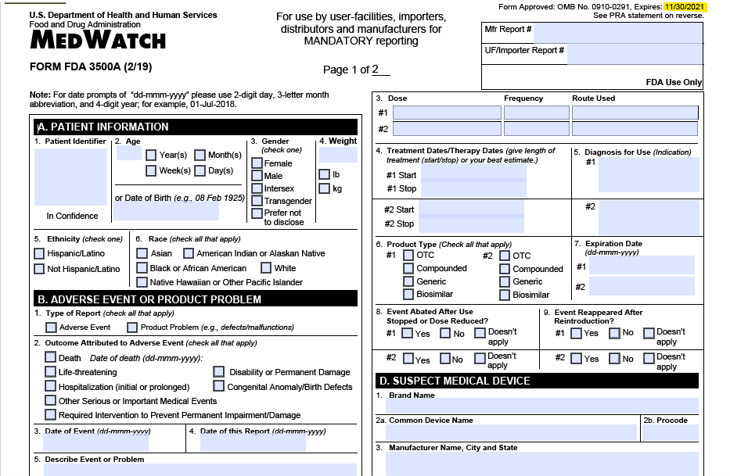
IND Safety Reporting
Safety Reports are sent to the FDA using the FDA Form 3500A (MedWatch)
FDA may require a sponsor to submit IND safety reports in a format or at a frequency different than that required.
The sponsor may also follow a different reporting format or frequency, which is usually proposed in the initial IND application.
If the adverse event/adverse reaction does not meet criteria for expedited FDA reporting, it would get reported either as an informational amendment or included the annual report.

Slide 27
IND Annual REPORTING

Slide 28
MAINTAIN THE IND REPORTING IND annual report
All INDs (including sINDs and eINDs) require annual reporting
Annual Reports must be submitted within 60 days (+/-) of the Anniversary date that the IND went into effect.
Sections Include:
1) Summary of the IND and Reporting Period
2) Summary Information
3) Protocol Modifications
4) Outstanding Business with Respect to the IND
Note: Modifications of the experimental design of Phase 1 studies that do not affect critical safety assessments are required to be reported to FDA only in the annual report. (312.23 IND Application)

Slide 29
IND annual Reports
The Annual Report needs to include the following information:
Title, protocol number, purpose, patient population, status of the study
The total number of subjects initially planned for inclusion in the study; the number entered into the study to date, tabulated by age group, gender, and race; the number whose participation in the study was completed as planned; and the number who dropped out of the study for any reason.
Summary information obtained during the previous year's clinical and nonclinical investigations, including if the study has been completed, or if interim results are known, a brief description of any available study results.

Slide 30
Other ind reporting for sponsors

Slide 31
Inactivation/reactivation
If no subjects are enrolled on the study for over two years, or the study is on clinical hold for longer than a year, the FDA may inactivate the IND.
If the sponsor would like to reactivate the IND, a protocol amendment must be submitted. The FDA will respond within 30 days of receipt.

Slide 32
Change in sponsor
To transfer ownership of an IND to another party, the holder needs to notify the FDA in writing. The letter should include the following:
Name of transferee
Address of transferee
Name of responsible official of transferee
Effective date of transfer
Signature of the transferring official
Typewritten name and title of the transferring official.
The new holder should submit a letter of acceptance of the transfer and an update of the information contained in the IND, where appropriate.

Slide 33
Withdrawal and termination
A Sponsor may choose to withdraw (or close out) an IND at any time, via a Close Out Report
All investigations end, protocol is also closed with the IRB
The FDA may decide to terminate an IND
This may be due to deficiencies in the IND, how a study was conducted, or if the study has been in inactive status for greater than 5 years
Templates available: Through the IND/IDE Support Program

Slide 34
Investigator Regulatory obligations

Slide 35
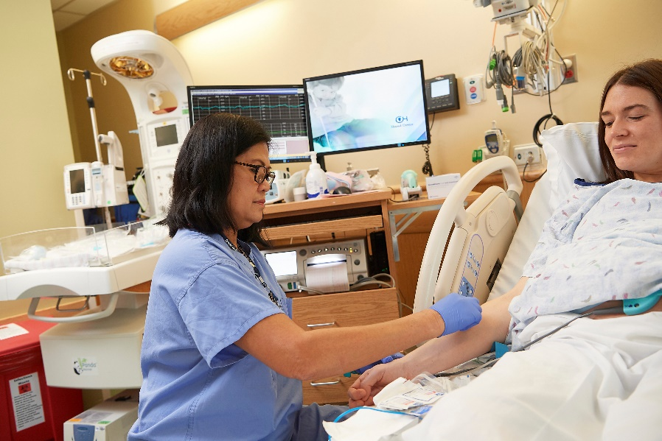
Summary: Regulatory obligations of an investigator
Personally supervise investigation
Protocol and regulatory compliance
Protect rights, safety, welfare of subjects
Obtain informed consent
Obtain and maintain subject case histories

Slide 36
Personally supervise the investigation
The investigator will:
personally conduct or supervise the study conduct at the site
ensure that individuals involved in the study conduct (ie on delegation of authority log) are informed about their obligations with regards to the study.
This includes (but is not limited t0):
Developing procedures as needed
Conducting training as needed
Holding and documenting routine meetings

Slide 37
Protocol & regulatory compliance
The Investigator must:
Adhere to the study protocol and ensure that the investigation at their site is conducted accordingly
Provide timely progress and final reports to the sponsor
Assure they have appropriate IRB approval and oversight
Promptly report to the IRB all changes in the research activity
Report all unanticipated problems involving risk to human subjects or others
Agree not to make any changes in the research without IRB approval, except where necessary to eliminate apparent immediate hazards to human subjects

Slide 38
Protect rights, safety, and welfare
An investigator is responsible for protecting the rights, safety, and welfare of study subjects
This includes reading and understanding the information in the investigator's brochure, including the potential risks and side effects of the drug
The investigator must also agree to report to the sponsor adverse experiences that occur in the course of the investigation(s)

Slide 39
Obtain informed consent
An investigator is required to obtain the informed consent of each subject who is enrolled to the study in accordance with regulations.
The investigator is responsible to inform any potential subjects that the drugs are being used for investigational purposes and will ensure that the requirements relating to obtaining informed consent are met.
Document the informed consent process (conducted prior to participation in the study)
Obtain both parental signatures, if required
Provide a copy of the consent to the subject/family

Slide 40
Subject case histories
An Investigator is responsible for maintaining case histories for all study participants.
This includes (but is not limited to):
Signed and dated consent forms, including documentation of informed consent process conducted prior to study participation.
Medical records (EPIC charts, progress notes, etc.)

Slide 41
Overlapping sponsor and investigator responsibilities

Slide 42
Summary of obligations
Monitoring Investigations
Selecting/Informing Investigators
Maintaining the IND with the FDA
Protocol Amendments
Informational Amendments
Annual Reports
IND Status Changes
Personally Supervise Investigation
Protocol and Regulatory Compliance
Protect Rights, Safety, and Welfare of Subjects
Obtain Informed Consent: Provide a copy to Subject
Obtain and Maintain Subject Case Histories/Binder
Recordkeeping
Investigational Drug Control
Inspection of Records
Financial Disclosure Information
Obtain and Maintain Subject Case Histories/Binder

Slide 43
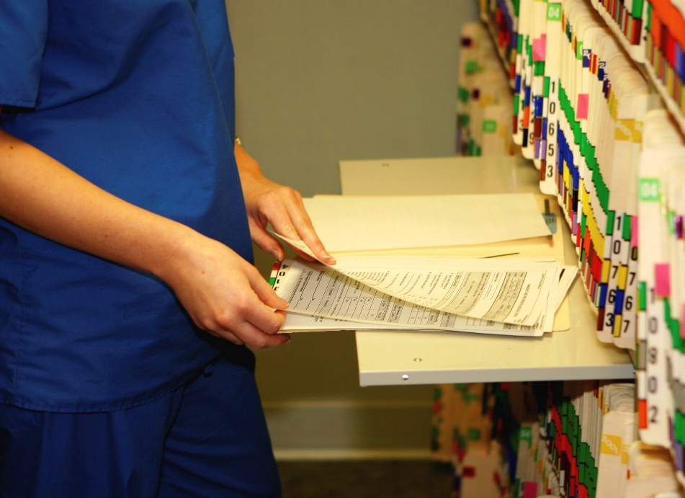
summary: sponsor & investigator
Recordkeeping
Regulatory
Investigational Product
Data collected under IND
Investigational Drug Control/
Accountability
Permit Inspection of records

Slide 44
Recordkeeping responsibilities
Recordkeeping Type | Sponsor Responsibility | Investigator Responsibility
Study Drug | Responsible for the receipt, shipment, and disposition of the study drug for all sites. | Responsible for the receipt and disposition of study drug, from when it gets on site to when it leaves the site.
Case Histories | The Sponsor maintains case histories. They keep the de-identified study data that is provided by the investigational sites. | The investigator is required to create and maintain study participant’s case histories.
Record Retention | Retain records for all sites for 2 years (after marketing application for drug is approved) or for 2 years after shipment of study drug was discontinued and FDA was notified. | Same as Sponsor; CHOP record retention policy requires records be maintained for at least 10 years after subject turns 18 (for greater than minimal risk studies).
Financial Interest | Responsible to maintain records of financial interest (generally financial disclosure forms) for all investigators at all sites | Responsible to maintain records of financial interest of investigators at the site; also responsible to update sponsor within 1 year of study closure with any updates

Slide 45
Investigational drug control
Sponsor:
Ships study drug to investigators participating in the investigation.
CHOP policy mandates use of the CHOP Investigational Drug Service for INDs
The sponsor ensures that all unused study drug (from sites) is either returned or destroyed.
Title 21 CFR 312.61, 312.69
Investigator:
Ensures the study drug is given only to study participants, and is administered under their supervision or by a delegated sub-investigator
Additional storage protections are required under Sec. 312.69 if the study drug is a controlled substance in order to prevent theft

Slide 46
Inspection of records: sponsor
FDA inspection:
A sponsor must upon request from any properly authorized officer or employee of the Food and Drug Administration, at reasonable times, permit such officer or employee to have access to and copy and verify any records and reports relating to the study.
Upon written request by FDA, the sponsor must submit the records or reports (or copies of them) to FDA. The sponsor must discontinue shipments of the drug to any investigator who has failed to maintain or make available records or reports of the investigation as required by this part.
CHOP Office of Research Compliance (ORC) inspection:
ORC has the right to inspect sponsor records upon request
Controlled substances:
If an investigational new drug is a substance listed in any schedule of the Controlled Substances Act, study drug records (shipment, delivery, receipt, disposition) must be made available to a DEA inspector.

Slide 47
Inspection of records: investigator
FDA inspection:
The same as the sponsor, an investigator must upon request from any properly authorized officer or employee of the Food and Drug Administration, at reasonable times, permit such officer or employee to have access to and copy and verify any records and reports relating to the study.
The investigator is not required to divulge subject names unless the records of particular individuals require a more detailed study of the cases, or unless there is reason to believe that the records do not represent actual case studies, or do not represent actual results obtained.

Slide 48
Summary of obligations
Monitoring Investigations
Selecting/Informing Investigators
Maintaining the IND with the FDA
Protocol Amendments
Informational Amendments
Annual Reports
IND Status Changes
Personally Supervise Investigation
Protocol and Regulatory Compliance
Protect Rights, Safety, and Welfare of Subjects
Obtain Informed Consent: Provide a copy to Subject
Obtain and Maintain Subject Case Histories/Binder
Recordkeeping
Investigational Drug Control
Inspection of Records
Financial Disclosure Information
Obtain and Maintain Subject Case Histories/Binder

Slide 49
References, resources, Questions
Sponsor-Investigator Responsibilities Guidance
IND Application Procedures: Investigator's Responsibilities
INDs Prepared and Submitted by Sponsor-Investigators - FDA Draft Guidance for Industry - https://www.fda.gov/media/92604/download
Sponsor Responsibilities—Safety Reporting Requirements and Safety Assessment for IND - https://www.fda.gov/media/150356/download
CBER Letter to Sponsors, Applicants and Regulated Entities on COVID-19 (June 9, 2022 update) https://www.fda.gov/media/136501/download

