Slide 1
Sponsor-Investigator IND training: module 1 Introduction to the IND
IND/IDE Support Program
May 8, 2023
Notes:
This course is intended for sponsors of INDs, which here at CHOP are generally individual physicians, as well as managers or RCs who would be completing submissions to the FDA (on behalf of the sponsor)

Slide 2
Overview
Introduction to Investigational New Drug Application (IND)
Drug Development Process Related to IND
Regulatory Requirements of an IND
Content and Format of an IND
IND Determinations: What to expect from the FDA
Expanded Access INDs
IND Sponsorship
Resources and References (please also see supplement packet)

Slide 3
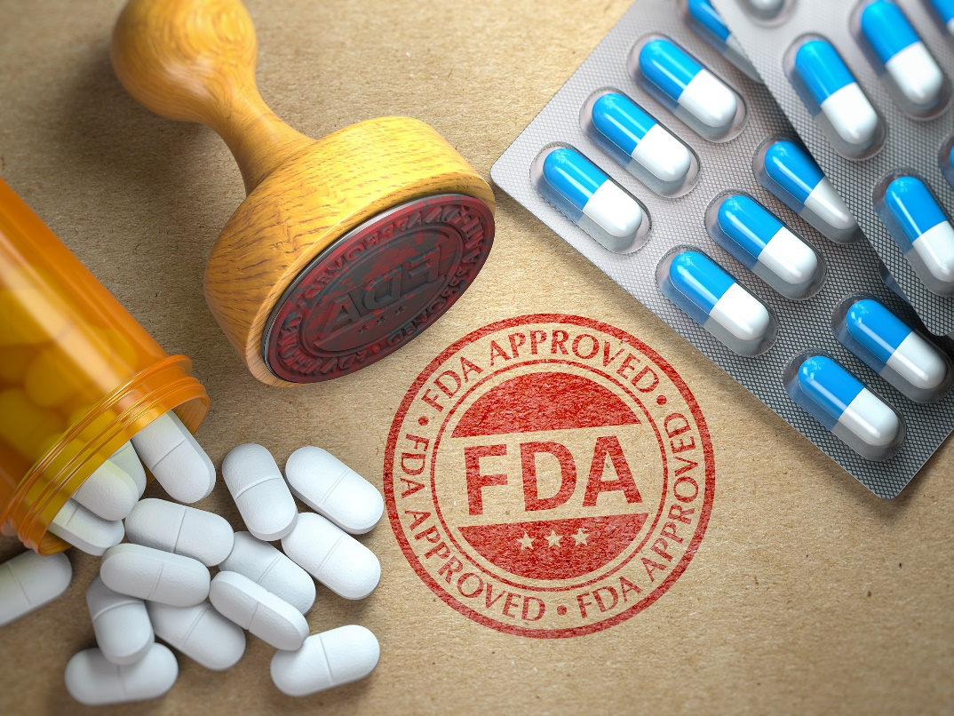
Introduction to the IND

Slide 4
An ind might be needed if…
The drug IS NOT approved for marketing in the US
Drug is currently only available for Investigational Use
Drug is only approved in another country
The drug IS approved for marketing in the US, but...
The population being studied (i.e. children) is not listed in the approved FDA label
Proposed use (indication) is not listed in the approved FDA Label
The investigation involves a route of administration, dose, patient population, or other factor that significantly increases the risk (or decreases the acceptability of the risk) associated with the use of the drug product (21 CFR 312.2 (b) (1) (iii))
The study IS intended to be reported to the FDA as a well-controlled study in support of a new indication or any other significant change in the labeling of the drug
Notes:
If an approved drug FDA label is such that there is no pediatric indication, it is not approved to be used in kids, and needs an IND

Slide 6
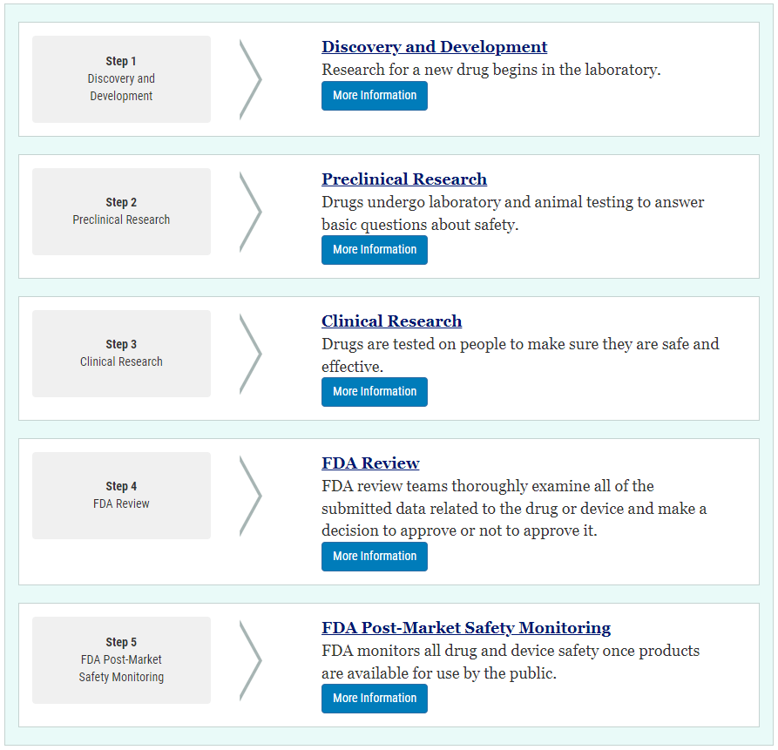
Drug development process
https://www.fda.gov/patients/learn-about-drug-and-device-approvals/drug-development-process
Notes:
Sponsor-Investigator INDs will primarily focus on these first three steps. Step 4 might be tackled if the intent was to commercialize and market a product. Most Sponsor-Investigator INDs are Research INDs. Publication intent.

Slide 7
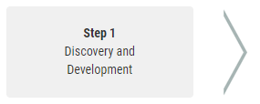
Drug development process
Step 1: Discovery and Development – discovery by...
Begins in the Laboratory
New insights, publications, presentations, conferences
Existing Treatments with desirable off-target effects
High throughput testing of existing molecular compounds
New Molecular Entity (NME) (Eureka Moment)
New Technology
Initial Bench Testing and Evaluation to determine
Absorption, Distribution, Metabolism, Excretion
Mechanism of Action
Overall Potential for Further Development

Slide 8
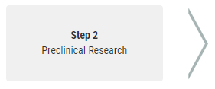
Drug development process
Step 2: Preclinical Research
In Vitro Testing
In Vivo Testing
Determine if the product is safe enough to move into human trials
Animal studies to determine
Safety – Toxicity
Initial Pharmacology
Absorption, Distribution, Metabolism, Excretion
Mechanism of Action
Overall Potential for Further Development

Slide 9
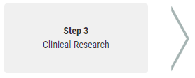
Drug development process
Step 3: Clinical Research
End Goal – Safety and Effectiveness
Data generated in Human Clinical Trials to Support Safety and Effectiveness
Designing Clinical Trials
Investigational Plan or Protocol
Study Population and Number of Subjects
Controls or Placebo
Dosage and Duration
Assessments and Outcome Measures
Clinical Research Study Phases

Slide 10
Clinical trial phases
Phase | Study Participants | Length of Study | Purpose
1 (Pilot) | 20-100 Maybe smaller 5-10 (Healthy or Affected) | Several Months | First in human, first in children Safety/side effects How is the drug metabolized PK/PD, Dose finding
2 | 100s (w/ Disease or Condition) | 2 Months to 2 Years | Preliminary efficacy endpoints Short term side effects
3 | 100s-1000s (w/ Disease or Condition) | 1-4 Years | Primarily an efficacy trial Safety – Risk/Benefit profile of the drug Multi-site
4 | 1000s (w/ Disease or Condition) | May be Longer Term | Post-Marketing Safety and Efficacy Long Term side effects
Note: some phases can be combined

Slide 11
IND As Clinical Investigations
Investigators are looking to study the use of a drug as part of a clinical investigation
Primary goal is assessing product safety and effectiveness
Data that is generated for publication in academia, and product development in industry
Can be any phase (I, II, III, or IV)

Slide 12
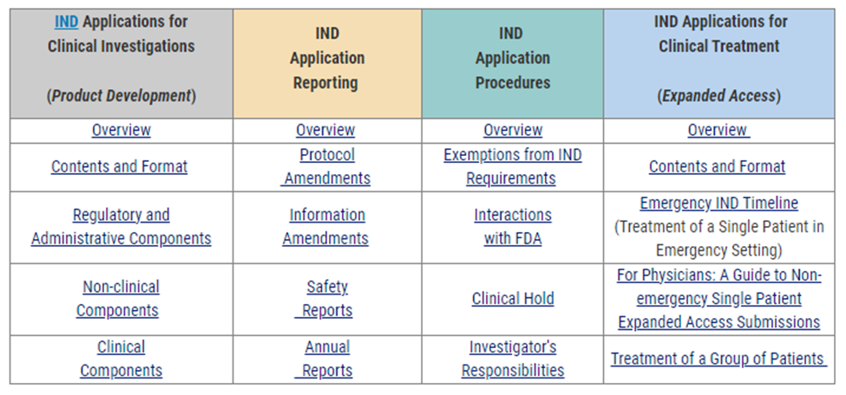
Investigator-Initiated ind applications
https://www.fda.gov/drugs/investigational-new-drug-ind-application/investigator-initiated-investigational-new-drug-ind-applications

Slide 13
Regulatory requirements and format of an investigational new drug application

Slide 14
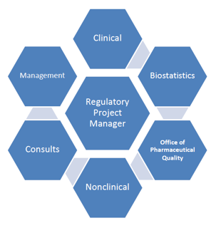
Drug development process
Step 3: Clinical Research
The Investigational New Drug (IND) Process
Regulatory Requirements (21 CFR 312)
Content and Format
FDA Review Team
Project Manager
Medical Officer
Statistician
Pharmacology/Toxicology
CMC
Chemist
Microbiologist
FDA Decisions and Determinations

Slide 15
General principles of the ind submission (21 cfr 312.22)
FDA’s Primary Objectives
Assure safety and rights of subjects, and quality of the scientific evaluation is adequate to evaluate the drug’s effectiveness and safety for market approval
Focus of initial IND submission
General investigational plan
Protocols for specific human studies
Novelty and developmental phase of the drug
The extent to which the study drug has been studied previously
The known or suspected risks
Notes:
The bolded words in this slide are the mantra of the FDA

Slide 16
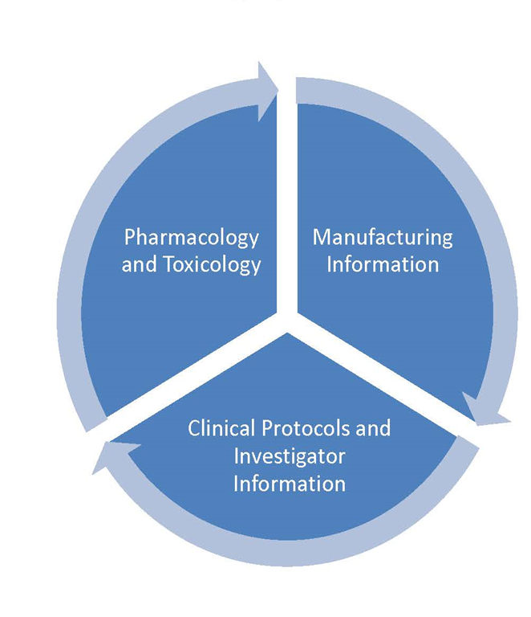
Ind application

Slide 17
Ind content and format
Cover Letter
Form FDA 1571
Form FDA 1572
Form FDA 3674
Table of Contents
First few sections are administrative information

Slide 18
Ind content and format
Introductory Statement and General Investigational Plan
Investigator's Brochure
Clinical Protocol(s)
Chemistry Manufacturing and Control Information
Pharmacology and Toxicology Information
Previous Human Experience
Additional Information
IND/IDE Support Office has templates and can assist with INDs

Slide 19
Order of ind application
Cover Letter
FDA Forms (1571, 1572, 3674)
Introductory Statement and General Investigational Plan
Previous Human Experience
Additional Information
Pharmacology and Toxicology Information
Investigator's Brochure
Chemistry Manufacturing and Controls Information
Table of Contents
Clinical Protocol(s)
Notes:
This comes from the regulations, and we will go through each section in the next slides

Slide 20
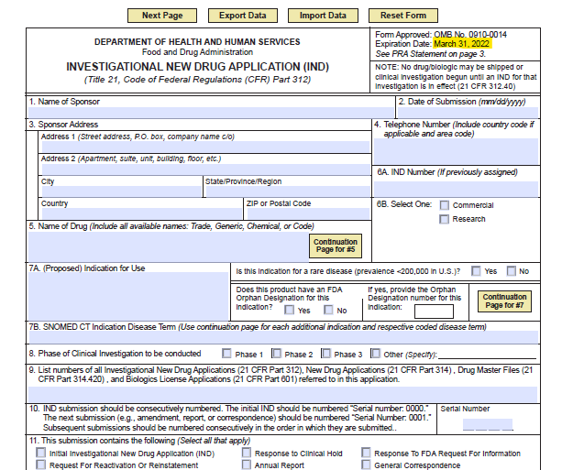
Form FDa 1571
In addition to being a cover sheet for the submission, this is also where the Sponsor agrees to conduct research according to FDA regulations

Slide 21
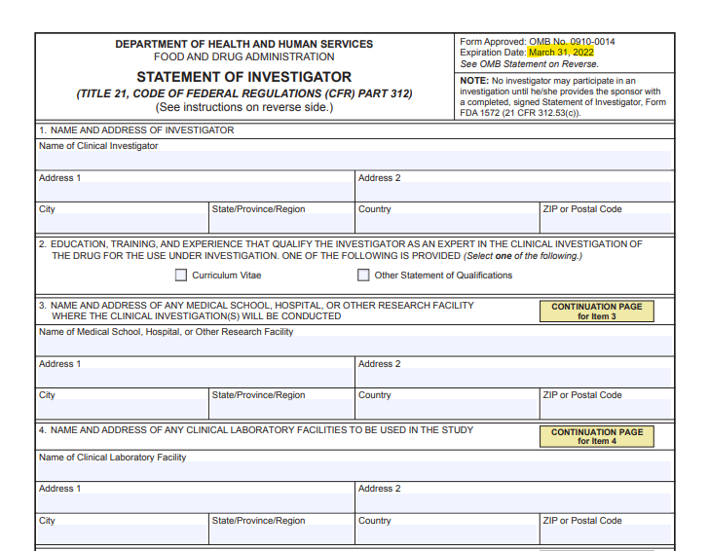
Statement of investigator: form fDA 1572
This form serves two purposes:
1) Provides site and investigator information
2) The Investigator agrees to conduct research according to FDA regulations
This form is required for each site that is participating in the study
Notes:
In multi-site studies, each site has its own 1572
Holds investigators legally responsible for what happens at a site during the conduction of a clinical trial

Slide 22
Form FDA 3674 clinicaltrials.gov registration
Purpose: Form FDA 3674 is a signed statement that the Sponsor will comply with clinicaltrials.gov requirements.
Registration and Reporting
To establish a clinicaltrials.gov account please contact:
Office of Research Compliance
ORC@chop.edu

Slide 23
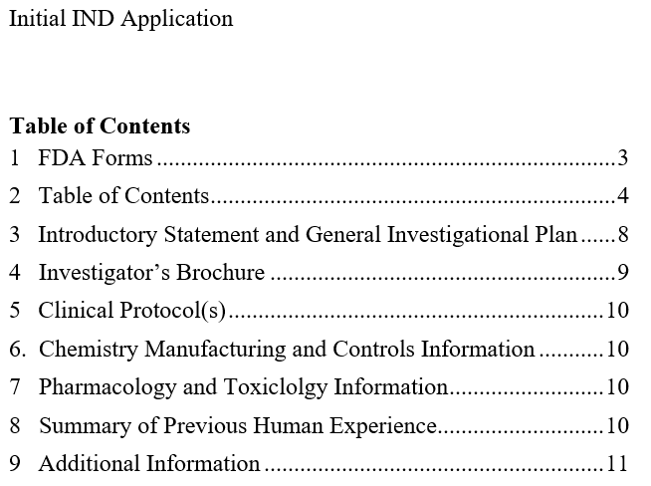
Table of contents

Slide 24
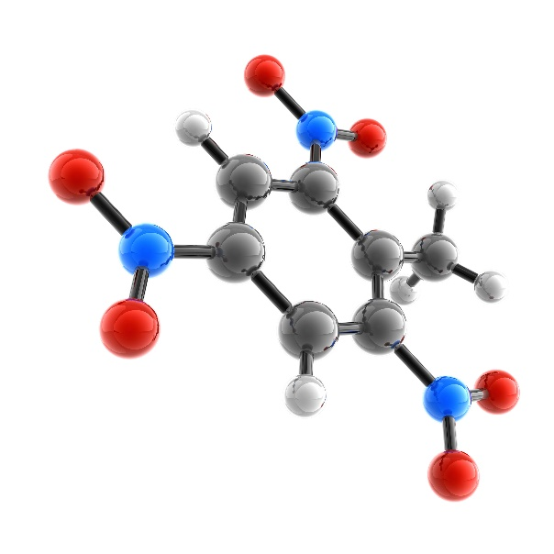
Introductory statement and general investigational plan
The brief introduction should include:
Name of the drug and all active ingredients
Drug's pharmacological class
Structural formula of the drug (if known)
Formulation of the dosage form(s) to be used
Route of administration
Broad objectives and planned duration of the proposed clinical investigation(s)
The brief summary should include:
Previous human experience with the drug
Reference to other INDs if pertinent
Reference to investigational or marketing experience in other countries that may be relevant to the safety of the proposed study
Notes:
This section is a helicopter view of what is going to go on in the study, usually is a paragraph or two

Slide 25
Introductory statement and general investigational plan
Brief description of the plan for investigating the drug product for the following year including:
The rationale for the drug or the research study;
The indication(s) to be studied;
The general approach to evaluate the drug;
The estimated number of patients; and
Any potential severe risks

Slide 26
investigator’s brochure
The Investigator’s Brochure (IB) includes:
A brief description of the drug
A summary of the effects of the drug in the body
A description of possible risks and side effects to be anticipated
Required for Multicenter Studies
Over the course of the study, changes to the IB are required to be reported to the IRB and FDA
If study drug is already FDA approved, include the Package Insert (not the IB)
Notes:
This documents tells investigational teams at other sites (in multi site studies) information about the drug (that is outside of the protocol) to help them understand how the drug works.

Slide 27
protocols
Basic elements of a clinical protocol (Use CHOP Templates)
Background/Significance/Rationale of Investigation
Investigational Product Information/Dose Rationale
Patient Population/Indication
Eligibility Criteria
Trial Endpoints/Schedule of Evaluations
Clinical Care vs Research Procedures
Safety Considerations/Risks/Stopping Rules
Data Safety Monitoring Plan/Safety Reporting/Management
Investigational Product Handling/Accountability
Regulatory Considerations: FDA and IRB Requirements
Publication Considerations
References
Notes:
The basic elements of the clinical protocol for the FDA are much like the CHOP interventional template

Slide 28
One protocol for each planned study
The clinical protocol on file with the IRB, FDA and DSMB (if applicable) should be the same (identical) version
Any change to the clinical protocol should be updated with the IRB, FDA and DSMB (if applicable), to ensure that each regulatory group has the identical protocol version
Include a new version date every time the protocol is updated

Slide 29
Relationships Ind, protocol, and sites
IND Drug/Indication
Protocol 1
Site 1-1
Site1-2
Protocol 2
Site 3-1
IND
Protocols
Sites
Protocol 3
Site 2-1
Notes:
This slide shows you that you can have 1 IND, but multiple protocol underneath it (the drug is the same, the patient population is the same, but the indication they are investigating is different)

Slide 30
CHEMISTRY, MANUFACTURING, AND CONTROLS (CMC) Information
Describes the composition, manufacturing, and control of the study drug (drug substance and drug product).
When the manufacturing of the investigational product occurs at CHOP or at Penn, the CMC section will be written by the manufacturer of the investigational product at CHOP or Penn
For most IND studies at CHOP, the CMC section is replaced by the Package Insert
Good manufacturing practice (GMP) guidelines provide guidance for manufacturing, testing, and quality assurance in order to ensure that a drug product is safe for human consumption.

Slide 31
Good Manufacturing Practices (GMP)
Current Good Manufacturing Practice (cGMP) is a system for ensuring that products are consistently produced and controlled according to quality standards. It is designed to minimize the risks involved in any pharmaceutical production that cannot be eliminated through testing the final product
Assure the identity, strength, quality, and purity of drug products by requiring that manufacturers of medications adequately control manufacturing operations
Following cGMP is mandatory in pharmaceutical manufacturing.
21 CFR Part 210. Current Good Manufacturing Practice in Manufacturing Processing, packing, or Holding of Drugs.
21 CFR Part 211. Current Good Manufacturing Practice for Finished Pharmaceuticals.
21 CFR Part 212. Current Good Manufacturing Practice for Positron Emission Tomography Drugs.

Slide 32
pharmacology and toxicology
Information in this section comes from pre-clinical data collected from animal testing or in vitro.
Describes how the study drug works in the body (absorption, distribution, metabolism and excretion)
Summarizes the effects of the drug in the body (usually tabulated)

Slide 33
previous human experience with the investigational drug
This section includes:
Detailed information about other studies where this drug was investigated/used previously (including in other countries), as it is relevant to the:
safety of the use of the drug
the study rationale
the effectiveness of the study drug
Publications used to support the IND should be included in the IND application

Slide 34
ADDITIONAL INFORMATION
In certain applications, special topic information may be needed
Drugs with a potential for dependence and/or abuse
Information from other studies of that drug
What additional protections are in place to mitigate potential issues
Radioactive drugs:
A calculation of how much radiation is absorbed and potential impact on the body/organs.
Phase 1 studies of radioactive drugs must include background information on how to calculate the dose of radiation absorbed in the body.

Slide 35
IND Goals and requirements
Clinical Development Goals:
Generate data to…
Establish that the drug will not expose humans
to unreasonable risks
Establish that the product is effective
Provide basis for labeling change
Provide basis for marketing the product
Requirements:
A sponsor shall submit an IND to the FDA if the sponsor intends to conduct a clinical investigation with an investigational new drug that is subject to 312.2(a).
A sponsor shall not begin a clinical investigation subject to 312.2(a) until the investigation has an IND which is in effect in accordance with 312.40.

Slide 36
FDA submission process
Research INDs can be submitted electronically
Non eCTD format acceptable
NextGen – CDER
Email to CBER_DCC
Electronic Submission Gateway (ESG) in eCTD
Entered into the FDA tracking system DARRTS
Document Archiving, Reporting, and Regulatory Tracking System
Assigned to division team and Regulatory Project Manager (RPM)
RPM will send an IND acknowledgement letter. (Receipt Date)
Reviewers from at least 3 areas are assigned to the IND
During 30-day review, Sponsor should be available

Slide 37
IND Determinations: What to Expect from the FDA
Initially – IND Acknowledgement Letter
States studies may not begin for 30 days from date of FDA receipt
May receive inquiries from RPM on behalf of review team
Inquiries may have limited time for responses
After 30 days studies may begin
May or may not receive a study may proceed letter
Clinical Hold – Usually initially communicated by phone
Followed by formal letter within 30 (additional) days.

Slide 38
IND Review Process
IND Applications Prepared and Submitted by Sponsor-Investigators

Slide 39
Clinical Holds
Clinical Hold may occur if
Insufficient information to allow FDA to determine studies can proceed.
FDA determines unacceptable risks or quality of investigational drug
Full Clinical Hold: study may not proceed until the questions are answered and FDA formally allows the study to proceed.
Partial Clinical Hold: delay or suspension of part of the study
Complete Response to Clinical Hold
Non-Hold Items
Will not impede starting study but should be considered
Address in separate submission
21 CFR 312.42

Slide 40
specific examples of clinical holds
Manufacturing Information/Drug Quality
Impurity profile presents health hazard
Chemical stability is inadequate
Pharmacology and Toxicology
Studies are not sufficient
Studies are poor quality (non GLP)
Clinical Protocol
Prior toxicities are not addressed
High potential for unpredictable acute reaction without consideration of staggered administration

Slide 41
Expanded access – Special type of IND
Provides a mechanism for access to investigational drugs for the treatment of a patient or patients.
Specific section of IND regulations just for Expanded Access
21 CFR 312.300
Four types
Individual Patient, Non-Emergency (312.310)
Individual Patient, Emergency (312.310(d))
Intermediate Size Patient Population (312.315)
Treatment IND or Protocol (312.320)
Sometimes referred to as "Compassionate Use"
Basic Criteria for ALL Expanded Access uses is the same

Slide 42
Criteria for expanded access
Treatment of a serious or life-threatening disease or condition
No comparable or satisfactory alternative therapy available
Product is being studied in a clinical trial for the same/similar use
The sponsor of the controlled clinical trials is actively pursuing, with due diligence, marketing approval and providing the investigational product under an Expanded Access will not interfere with the enrollment in the ongoing clinical investigation
There is sufficient evidence of safety, and the potential benefits outweigh the potential risks

Slide 43
Criteria for a Single Patient IND
Serious or immediately life-threatening disease or condition
No comparable or satisfactory alternative therapy to diagnose, monitor or treat the disease or condition
The potential patient benefit justifies the potential risks of the treatment use, and the risks are not unreasonable in the context of the disease or condition
The sIND will not interfere with the initiation, conduct or completion of clinical investigations that could support marketing approval or compromise development of the expanded access use
Note: FDA & IRB must approve or concur of the use of the drug prior to administration, and there is adequate time for both to do so

Slide 44
Criteria for an Emergency IND
A life-threatening or severely debilitating situation
High likelihood of death
Major and irreversible morbidity
No standard acceptable treatment available
No comparable or satisfactory alternative therapy
Patient may benefit from use of an investigational drug BUT
Patient does not meet the criteria of an existing study protocol, or
Approved study protocol does not exist
Insufficient time to obtain IRB approval
Need for investigational drug does not allow time for submission/review and approval by IRB (Sponsor should still contact IRB, and the IRB will let them know if there is enough time to review)
Need for investigational drug also does not allow time for submission to FDA in the usual manner

Slide 45
Fda form 3926 individual Patient Ind
FDA Form 3926 is a streamlined IND application for an individual patient
(For either non-emergency IND [sIND] or emergency IND [eIND])
Elements
Subject description and clinical history
Investigational drug description and rationale for use in the subject
Treatment plan
Dose modification plan
For example, if ineffective at a given dose or toxicity at a certain dose
Adverse event reporting
Identification of toxicity scale, or definitions of severity grades
Reporting to include IRB, FDA, drug manufacturer and DSMB (if applicable)
Monitoring plan
Notes:
ORC can help with completing this form

Slide 46
Responses for Expanded access ind
Non Emergency Single Subject or Treatment IND
Single Subject INDs may be permitted to proceed prior to the 30 day review period, but ONLY if written approval is granted by the FDA.
Emergency IND
The FDA will respond via phone, email, or with a formal letter within 24 hours with approval or disapproval of the application request.

Slide 47
Introduction to Ind sponsor and Investigator Responsibilities

Slide 48
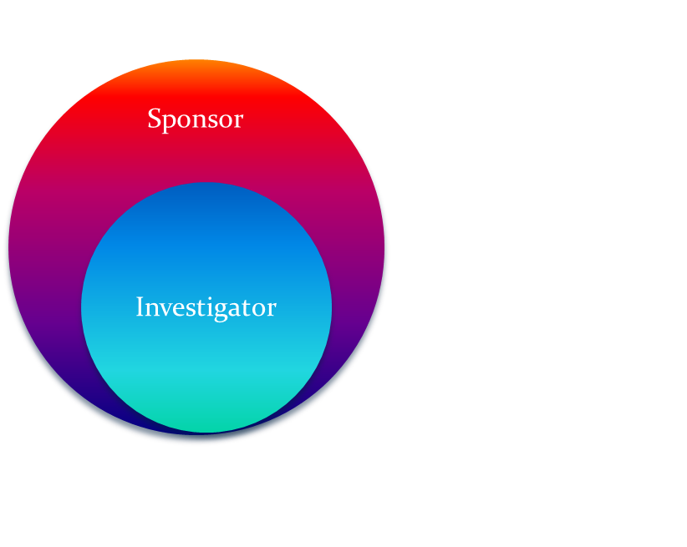
Sponsor and investigator responsibilities
Sponsor and Investigator
Separated Responsibility
Sponsor-Investigator
Compounded Responsibility
Sponsor
Investigator
Notes:
Big drug company/Pharma model is the left; On right here in academia it is more commonly like this

Slide 49
Communication with the fda
Notes:
With industry sponsor, communication from FDA normally goes through the sponsor to site PIs, but for Sponsor-Investigator studies FDA communicates directly to the PI

Slide 50
Pre-ind meetings
A sponsor/sponsor-investigator can reach out to the FDA about their proposed study (prior to submitting an IND application) by scheduling a Pre-IND Meeting
This might be advantageous in cases when:
They are unsure if their study would need to be under an IND
The Sponsor would like prescriptive feedback from the FDA they can incorporate into the proposed protocol
There is a novel indication or the drug itself is a new molecular entity
There are aspects of the study drug (ex: pharmacology, toxicology), that the FDA might be more knowledgeable about
This meeting can be in-person, via teleconference, or in-writing
Please see attached supplement for additional information

Slide 51
Key Points to remember:
Material in a foreign language:
If any material in the IND application is not in English, provide the original document and an English translation.
Submission Method (Current CHOP Preferred):
Submissions to CDER are made electronically using NextGen Portal
Submissions to CBER are made electronically by email to CBER_DCC
Serial Numbers for IND submissions:
The initial IND is assigned serial number 0000; each subsequent submission (e.g., amendment, report, correspondence) is sequentially and incrementally numbered (0001, 0002, 0003, etc).
Per CHOP Policy, all FDA Correspondence is required to be provided to IND/IDE Support (INDIDE@chop.edu).

Slide 52
references
21 CFR 312
How Drugs Are Developed and Approved
Investigational New Drug (IND) Applications
FDA Guidance Documents
Investigator Initiated Investigational New Drug (IND) Applications
IND Application Procedures: Overview

